Slide 1
Graphs
Presented by s.r.zameer

Slide 2
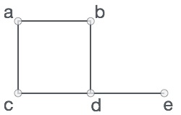
Graphs
A graph is a pictorial representation of a set of objects where some pairs of objects are connected by links. The interconnected objects are represented by points termed as vertices, and the links that connect the vertices are called edges.
Formally, a graph is a pair of sets (V, E), where V is the set of vertices and E is the set of edges, connecting the pairs of vertices.
V = {a, b, c, d, e}
E = {ab, ac, bd, cd, de}

Slide 3
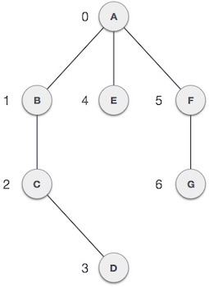
Graph Data Structure
Vertex − Each node of the graph is represented as a vertex.
Edge − Edge represents a path between two vertices or a line between two vertices.
Adjacency − Two node or vertices are adjacent if they are connected to each other through an edge.
Path − Path represents a sequence of edges between two vertices.

Slide 4
Basic Operations
Add Vertex − add a vertex to a graph.
Add Edge − add an edge between two vertices of a graph.
Display Vertex − display a vertex of a graph.

Slide 5
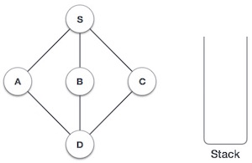
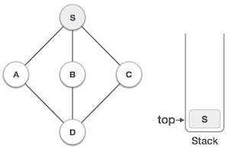
Inserting
Initialize the stack
Mark S as visited and put it onto the
stack. Explore any unvisited adjacent
node from S. We have three nodes
and we can pick any of them.

Slide 6
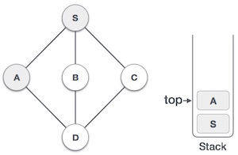
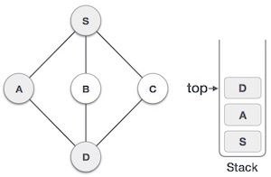
Conti….
Mark A as visited and put it onto the
stack. Explore any unvisited adjacent
node from A. Both S and D are adja-
cent to A but we are concerned for
unvisited nodes only.
Visit D and mark it visited and put onto
the stack. Here we have B and C nodes
which are adjacent to D and both are
unvisited.

Slide 7
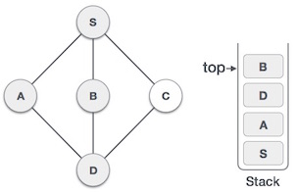
Conti….
We choose B, mark it visited and put onto stack. Here B
does not have any unvisited adjacent node.

Slide 8
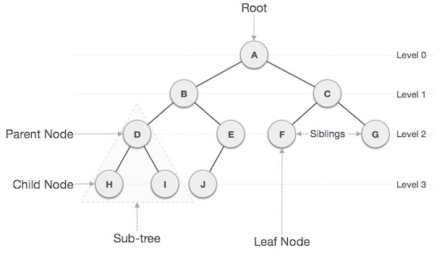
Binary tree
We choose B, mark it visited and put onto stack. Here B
does not have any unvisited adjacent node.

Slide 9
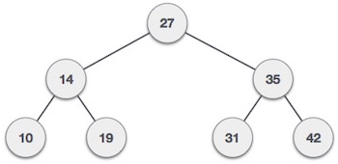
Binary Search tree
Binary Search tree exhibits a special behavior. A node's
left child must have value less than its parent's value and
node's right child must have value greater than it's parent
value.

